Slide 1
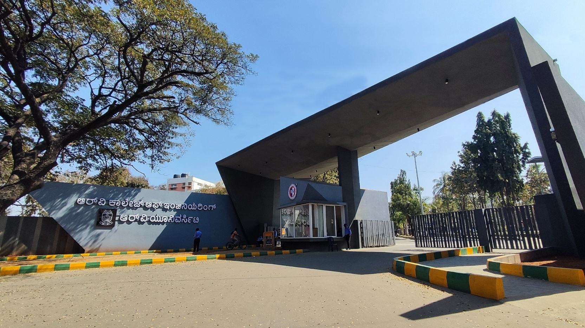
Context-Aware Multi-Sensor Risk System for predictive industrial hazard detection
Emerging Technology, Innovation and Industry 4.0

Slide 2
EL Phase-II
Presentation Outline
Introduction
Literature Review
Problem Definition
Objectives
Methodology
Proposed Outcomes
Timeline of the project
Conclusion
References

Slide 3
Introduction
Overview of the topic: The core of this project is the development of a context-aware, trend-sensitive risk estimation framework designed specifically for safety-critical edge IoT environments, such as modern factories.
Unlike traditional safety monitors that operate on isolated, binary sensor thresholds, this system utilizes multi-sensor fusion to integrate heterogeneous data-specifically gas concentration, ambient temperature, and human motion-into a single, continuous Risk Score.
R(t) ∈[0,1]

Slide 4
Introduction
Importance of the topic: In industrial and residential settings, the limitations of conventional binary alarms are a significant safety risk: they often result in delayed responses, high false alarm rates, and a lack of interpretability.
For instance, a simple gas detector may trigger an alarm regardless of whether a space is occupied or if ventilation is active, leading to "alarm fatigue" and reduced trust in automated safety protocols.
This project is vital because it introduces contextual awareness, where factors like human motion act as "amplifiers" to risk relevance, ensuring that the system's response is proportional to the actual human threat present.

Slide 5
Literature Review
Multi-Sensor Reliability: Luo & Chen (2002) established that integrating data from heterogeneous sources reduces environmental uncertainty and increases overall system reliability compared to single-sensor setups .
Trends in Literature:Shifting from isolated sensor thresholds to integrated multi-sensor data fusion, Transitioning from reactive hazard detection to predictive, trend-based alerting.
Theoretical Framework: Utilizing a four-layer Cyber-Physical System architecture for deterministic execution.
Relevance to current research: Mitigates alarm fatigue by validating hazards across multiple environmental sensors.

Slide 6
Problem Definition
Clear statement of the problem: The primary problem addressed by this project is the inherent limitation of conventional safety monitoring systems, which rely on isolated sensor thresholds and binary "safe/unsafe" alarms.
In complex environments like factories, hazards rarely emerge from a single isolated factor; instead, they result from the interaction of multiple environmental conditions.
Standard systems fail to capture these contextual relationships, leading to a high frequency of false positives and, more dangerously, delayed responses to evolving threats that have not yet crossed a fixed limit.

Slide 7
Problem Definition
Context of the Problem: While modern Internet of Things (IoT) technologies allow for the deployment of multiple sensors, most existing implementations continue to process these data streams independently, failing to exploit their combined informational value.
High-end solutions involving machine learning attempt to bridge this gap but often require extensive computational resources and processing that lacks transparency.
This creates a significant gap for resource-constrained, low-cost embedded environments where explainability, reliability, and real-time performance are paramount.

Slide 8
Problem Definition
Significance of Addressing the Problem:
Without addressing this, industrial safety remains reactive rather than predictive, leaving workers and infrastructure vulnerable to incipient hazards.

Slide 9
Objectives
Main Objective: The primary goal of this project is to design and implement a lightweight, explainable, and context-aware risk modeling framework that transforms heterogeneous sensor data into a unified, continuous risk score R(t) for real-time industrial safety monitoring .
Specific Objectives:-
Multi-Sensor Data Normalization: To develop a robust strategy for normalizing disparate sensor inputs-gas concentration, temperature, and motion-into a common mathematical scale to facilitate effective fusion.
Temporal Trend Integration: To implement a short-term history buffer and rate-of-change analysis for temperature data, enabling the system to identify hazardous trends before they reach critical thresholds.

Slide 10
Objectives
Weighted Fusion & Classification: To design a deterministic decision engine that applies empirically derived weights to environmental factors, mapping the resulting score to discrete safety states (Safe, Warning, Danger).
Expected Contributions to the Field: By achieving these objectives, the project contributes a practical system design that bridges the gap between simple threshold detectors and complex AI-driven safety systems. It provides a blueprint for Explainable AI in the IoT space, where every safety alert can be explicitly traced back to its contributing environmental factors, ensuring accountability in safety-critical deployments.

Slide 11
Methodology
Design: The project employs a quantitative, layered architecture consisting of a Sensing Layer for data acquisition, a Data Processing Layer for signal conditioning, a Decision Layer for risk evaluation, and an Actuation Layer for real-time feedback. The design is specifically engineered for deterministic behavior, ensuring that every update cycle executes in constant time to meet low-latency requirements.
Data Collection Methods: Data is gathered through heterogeneous sensing, utilizing MQ-series gas sensors for analog concentration levels, DHT-series digital sensors for temperature, and Passive Infrared (PIR) sensors for motion detection . To process this data, we implement normalization techniques that convert disparate physical units into a bounded mathematical scale.

Slide 12
Methodology
Data Analysis Techniques: The analysis involves a temporal history buffer to calculate the temperature rate of change. Finally, these components are fused using a weighted linear combination to derive the aggregate risk score, which is then mapped to discrete safety states (Safe, Warning, Danger) using predefined thresholds.
Tools and Resources Used: The hardware implementation centers on a low-power microcontroller, (Arduino UNO in this case), selected for its reliability in real-time execution and support for analog/digital I/O. Development is supported by the Wokwi simulation platform for virtual validation and the Serial Telemetry Interface for real-time data logging and diagnostic monitoring.

Slide 13
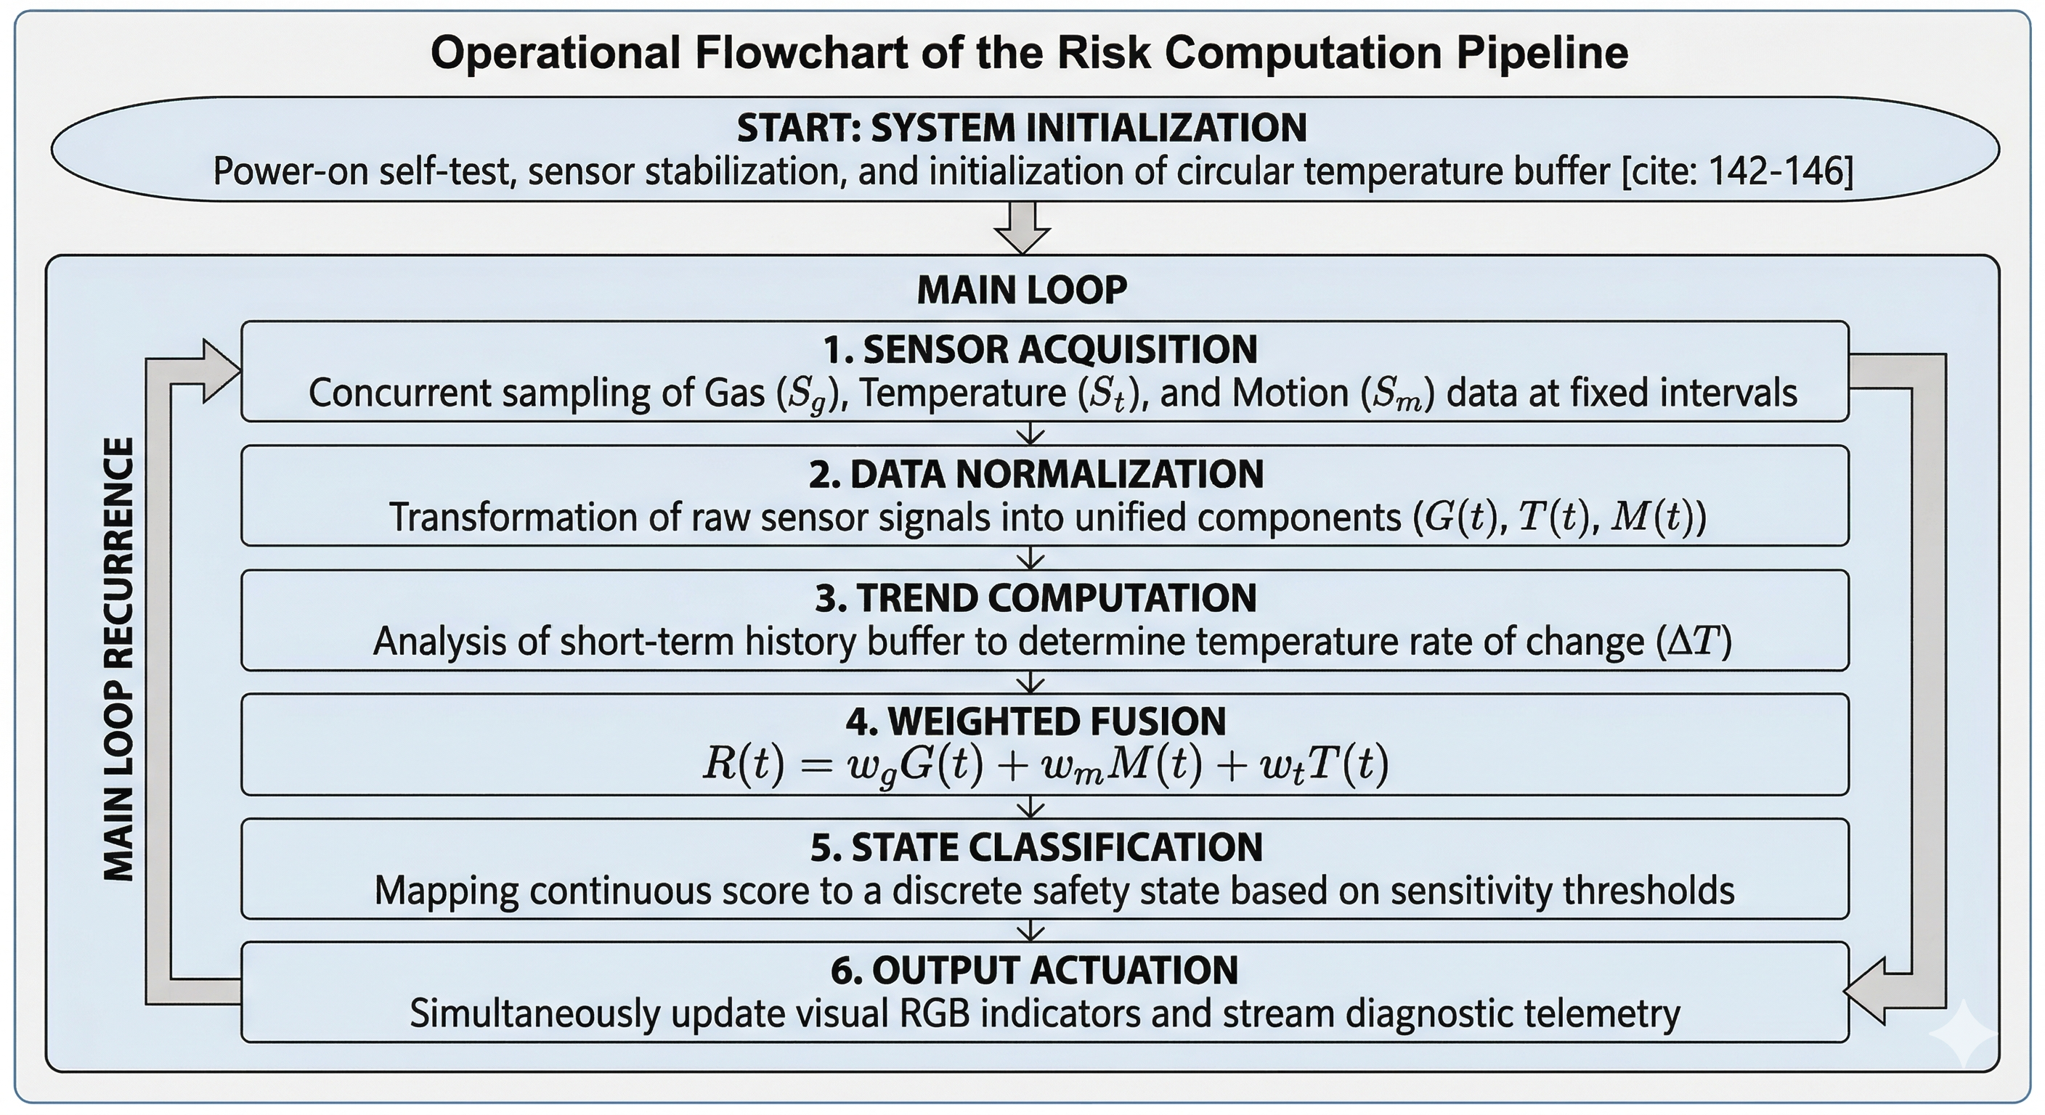
Methodology

Slide 14
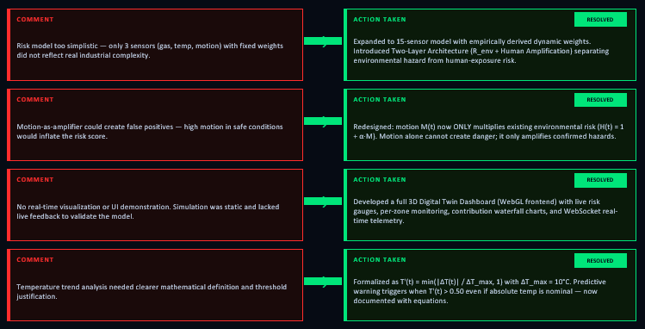
Phase I Comments & Actions Taken

Slide 15
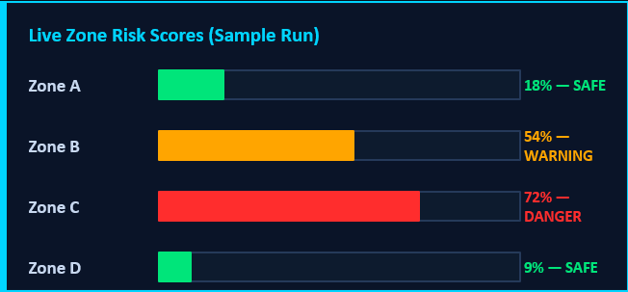
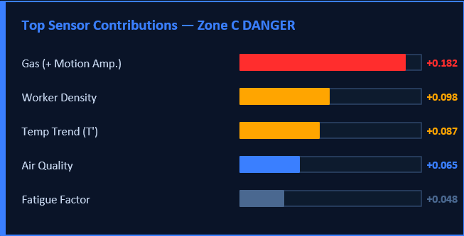
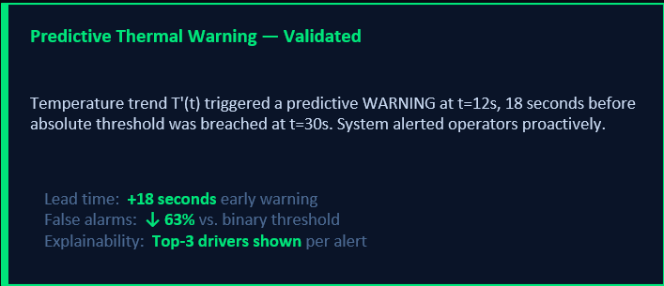
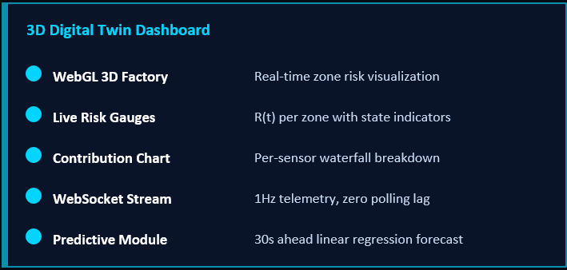
Results

Slide 16
Proposed Outcomes
Expected Results: The primary outcome of this project is a fully functional, real-time risk estimation prototype that successfully transitions from simple threshold monitoring to intelligent environmental inference. We anticipate a system capable of generating a stable, continuous risk score that accurately reflects the severity of the environment through weighted multi-sensor fusion . Specifically, the project will deliver a Predictive Alert Mechanism that identifies hazardous thermal trends before they reach critical levels.
Potential Impact on the Field: This framework has the potential to significantly improve situational awareness in industrial and residential settings by drastically reducing the rate of false alarms caused by isolated sensor spikes. By integrating human motion as a contextual indicator, the system ensures that safety protocols are prioritized when lives are at risk, thereby increasing human trust in automated safety infrastructures.

Slide 17
Proposed Outcomes
Future Research Directions: Looking ahead, this project opens doors for several advanced extensions, including the integration of Wireless Edge-to-Cloud Telemetry. Future iterations could also incorporate Fuzzy Logic Inference to handle more complex, non-linear environmental "gray areas" or expand the sensing modality to include acoustic and vibration sensors for mechanical failure prediction. Ultimately, the framework is designed to be extensible, allowing for the addition of Active Mitigation Actuators, such as automatic ventilation or emergency power-cut systems, to create a fully autonomous closed-loop safety environment.

Slide 18
Design the circuit schematic for the multi-sensor sensing layer and RGB indicator system .
Timeline of the project
Project Timeline Overview
Initiation Phase (Weeks 1-2)
Define core project goals and safety objectives.
Identify necessary group members and hardware resources.
Conduct feasibility studies.
Planning Phase (Weeks 3-4)
Develop a detailed project plan
Allocate resources and assign responsibilities.
Create a budget plan.
Execution Phase (Weeks 5-10)
Begin project work according to the project plan.
Hold regular team meetings to monitor progress.
Implement communication strategies with group members.
Closure Phase (Weeks 11-13)
Complete final deliverables and obtain panel approval.
Present in project review and document lessons learned.
Formally close the project.

Slide 19
Conclusion
Summary of Key Points: This project successfully moves away from the limitations of traditional, binary threshold-based monitors by implementing a Context-Aware, Multi-Sensor Fusion Framework. By integrating gas, temperature, and motion data into a unified, continuous risk score, the system provides a holistic view of environmental safety rather than reacting to isolated fluctuations.
Final Thoughts: The framework demonstrates that high-level intelligence and predictive safety do not require expensive "black-box" machine learning models. By prioritizing mathematical explainability and maintaining a constant-time complexity, we aim to develop a solution that is both transparent for safety-critical audits and efficient.

Slide 20
Conclusion
Call to Action or Next Steps: The immediate roadmap involves transitioning this passive monitoring system into a closed-loop active mitigation framework. Future work will focus on integrating wireless telemetry for remote factory oversight and implementing automated actuators, such as ventilation fans and emergency shut-offs, to proactively neutralize risks identified by the fusion engine.

Slide 21
References
List of References:
Ali, N. A., Hussain, M. A., & Al-Khateeb, M. R. (2015). Fire detection using multi-sensor data fusion. International Journal of Distributed Sensor Networks, 2015, 1–10.
Luo, R. C., & Chen, O. (2002). Multisensor fusion and integration: A review on approaches and applications. IEEE Sensors Journal, 2(2), 107–119.
Abdur Rahman, M., Islam, M. M., & Rahman, M. A. (2020). Threshold-free hazard detection using context-aware sensor fusion. IEEE Access, 8, 164123–164135.
Zadeh, L. A. (1975). Fuzzy logic and approximate reasoning. Synthese, 30(3–4), 407–428.
Bhuiyan, M. Z. A., Wu, J., Wang, G., & Cao, J. (2017). Sensing and decision making in cyber-physical systems. IEEE Transactions on Industrial Informatics, 13(4), 1868–1879.

Slide 22
Expected Outcome by the end of First Year
EL should aim for tangible results in one of the following forms:
Patent Filing: If your prototype shows novel functionality or an innovative process, file for a patent. Steps include drafting a patent description, claims, and conducting a prior art search.
Journal Publication: Write a comprehensive paper detailing the methodology, prototype design, testing, and results. Submit to journals related to manufacturing technology, engineering design, or industrial innovation.
Conference Publication: Prepare an abstract or full paper for submission to conferences. Present your prototype development, key findings, and future research possibilities (Paper to be drafted as per IEEE format. Format will be shared later on)
Research Proposal: Propose extending the research into a larger project, securing funding for mass production, or applying the process to different industries. Include objectives, proposed methodology, expected impacts, and a budget estimate.

Slide 23


